Slide 1
Machine Learning
Team Visionaries:
Hetkumar Patel,
Chaitanya Movva,
Vijay Vanapalli

Slide 2
Project Objective
Our Project aims to automate various diseases and tumor diagnosis using deep learning, specifically CNNs, to interpret chest X-rays accurately. In particular, it focuses on lung cancer using public datasets.
We utilize the NIH Clinical Center dataset comprising 100,000 annotated chest X-ray images for training and validation, but subset to 5000 images due to device compute constraints
The objective to solve is a Multi-label classification problem where each Lung X-ray can be classified as one of the following diseases/conditions:
'Cardiomegaly', 'Emphysema', 'Effusion', 'No Finding', 'Hernia',
'Infiltration', 'Mass', 'Nodule', 'Atelectasis', 'Pneumothorax',
'Pleural_Thickening', 'Pneumonia', 'Fibrosis', 'Edema', 'Consolidation'

Slide 3
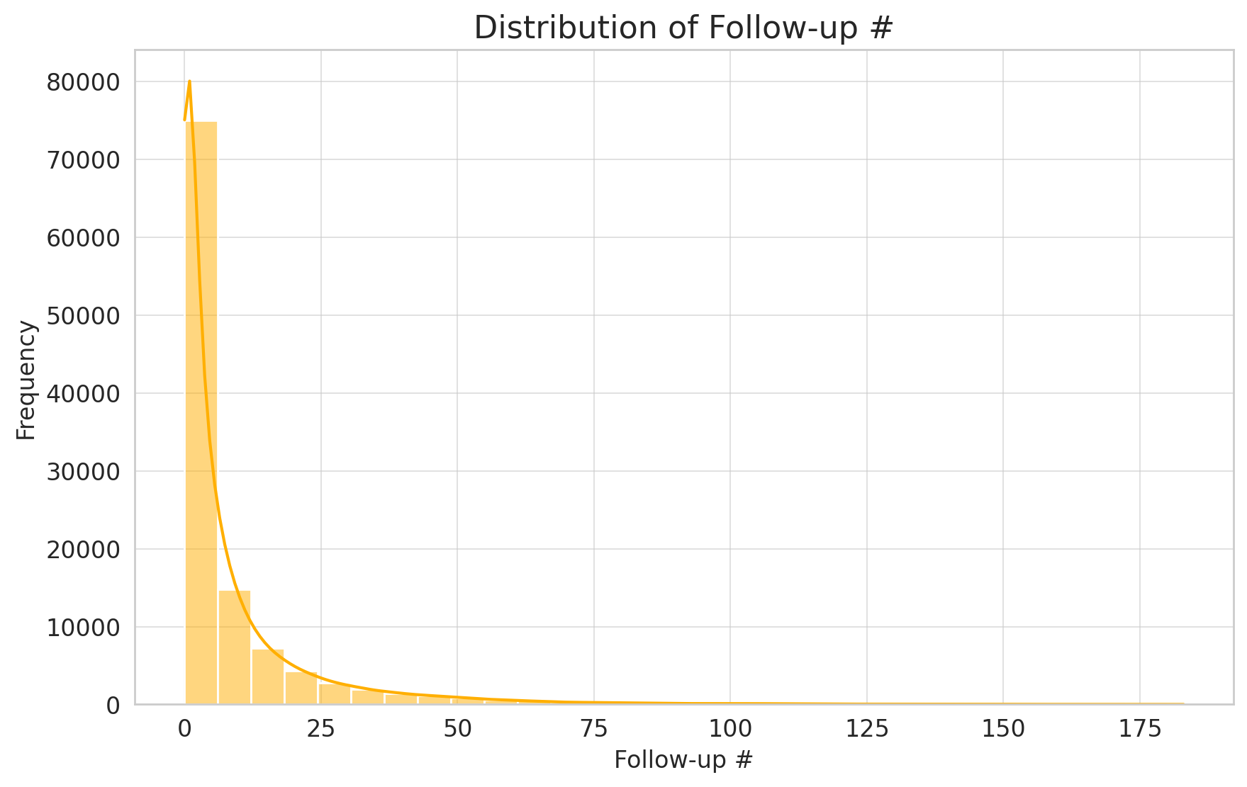
Distribution plot on Follow-up Visits

Slide 4
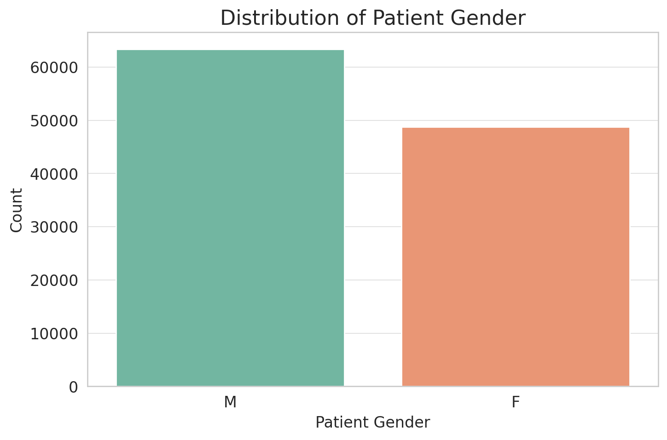
Distribution plot on Patient Gender

Slide 5
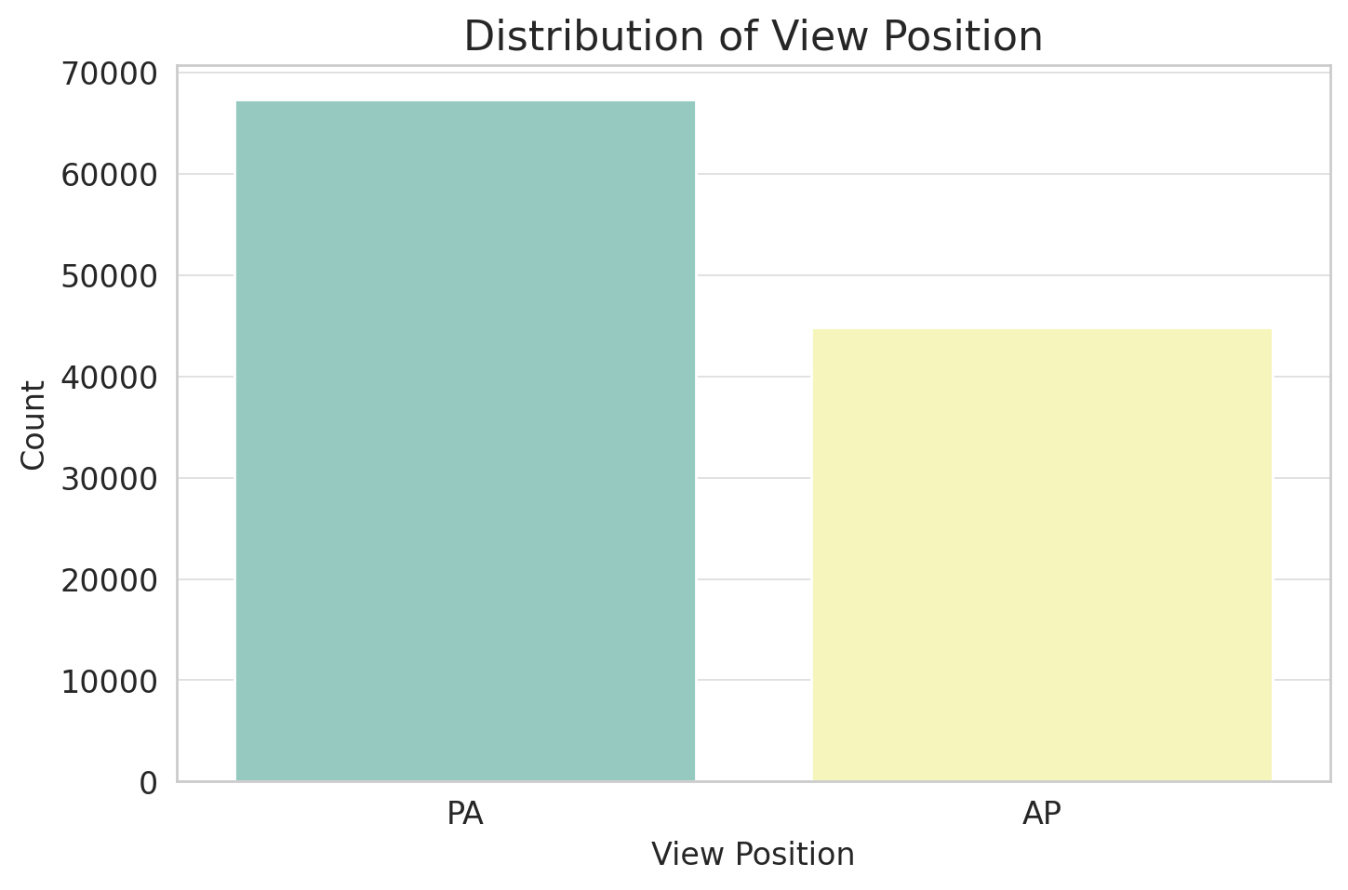
Distribution plot on View Position
PA (Posteroanterior)
AP (Anteroposterior)

Slide 6
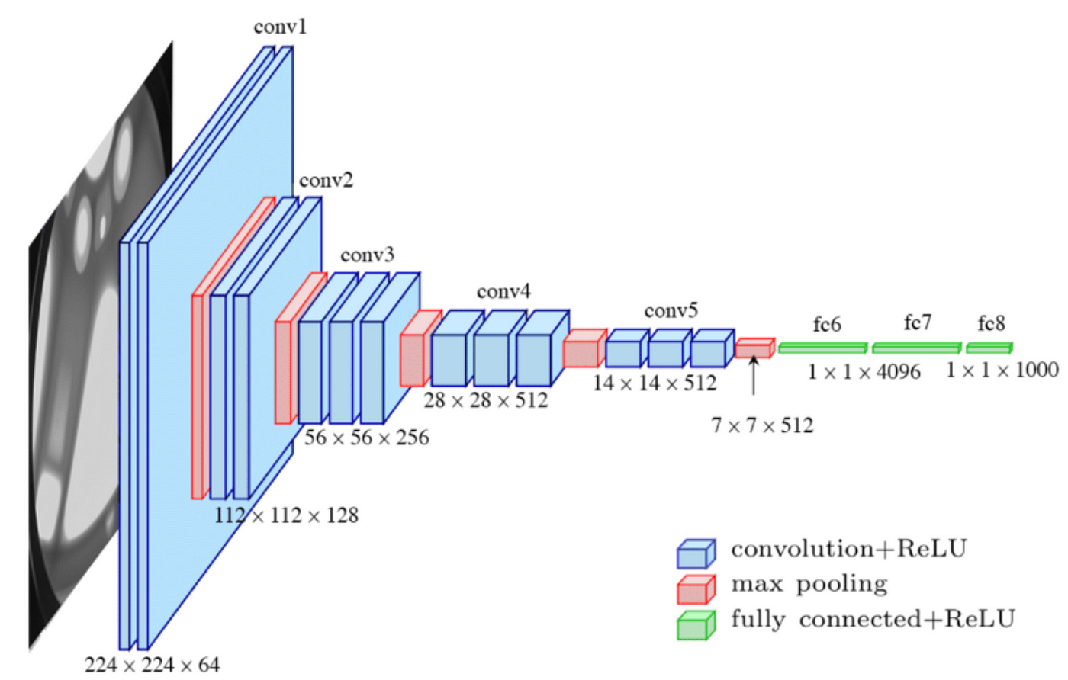
Model: VGG16 (Baseline)
VGG16 classifies chest X-rays into normal, pneumonia, cardiomegaly; automates diagnosis.
VGG16 extracts features for hybrid models, enhancing disease identification and classification accuracy.
Pre-trained VGG16 on chest X-rays using learned features adapts on image classification, thereby improving performance even on relatively small dataset.

Slide 7
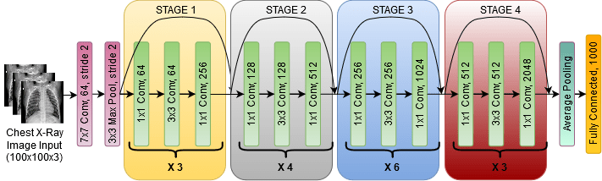
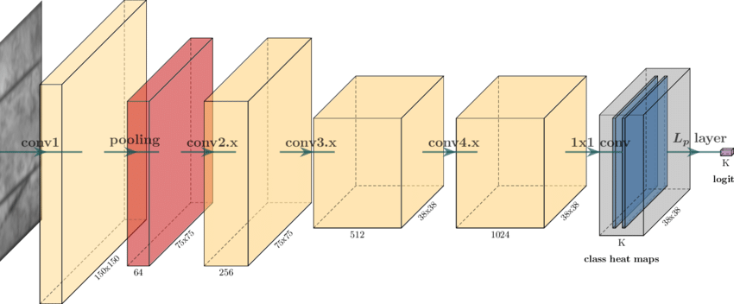
Model: ResNet50
ResNet50, know for its “residual blocks,” trains deep networks effectively without gradient issues, excelling in tasks requiring both accuracy and efficiency.
Provides a balance between depth and performance by utilizing residual connections, thus high performance with relatively lower complexity.
Widely used due to its robustness and its ability to maintain performance across different domains, especially medical image analysis.

Slide 8
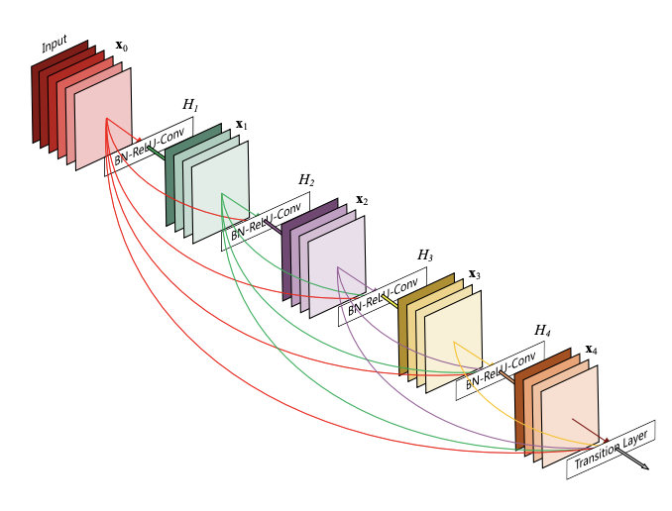
Model: DenseNet-121
DenseNet-121; know for its efficiency in feature utilization due to its densely connected layers, reducing gradient problem, and improves feature propagation.
Prevents overfitting by reusing features, ensuring it generalizes well to new, unseen images, crucial for medical tasks.
It has been used in real projects like CheXNet Localization, showing it's effective in practical situations.

Slide 9
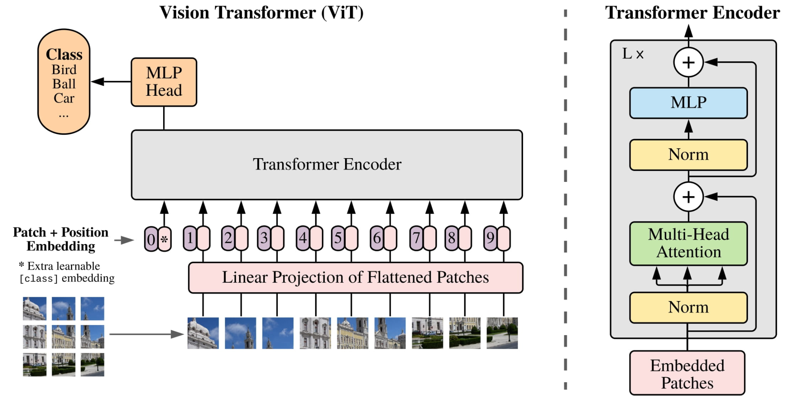
Model: VisionTransformer_224
ViT base patch 16-224-in21k: utilizes a transformer-based architecture applying self-attention mechanisms, making it highly effective for complex image recognition tasks.
Unlike older models, VIT works well with lots of data, making it useful for big datasets.
It's great for tasks where understanding the whole image is important, like recognizing objects in complex scenes.

Slide 10
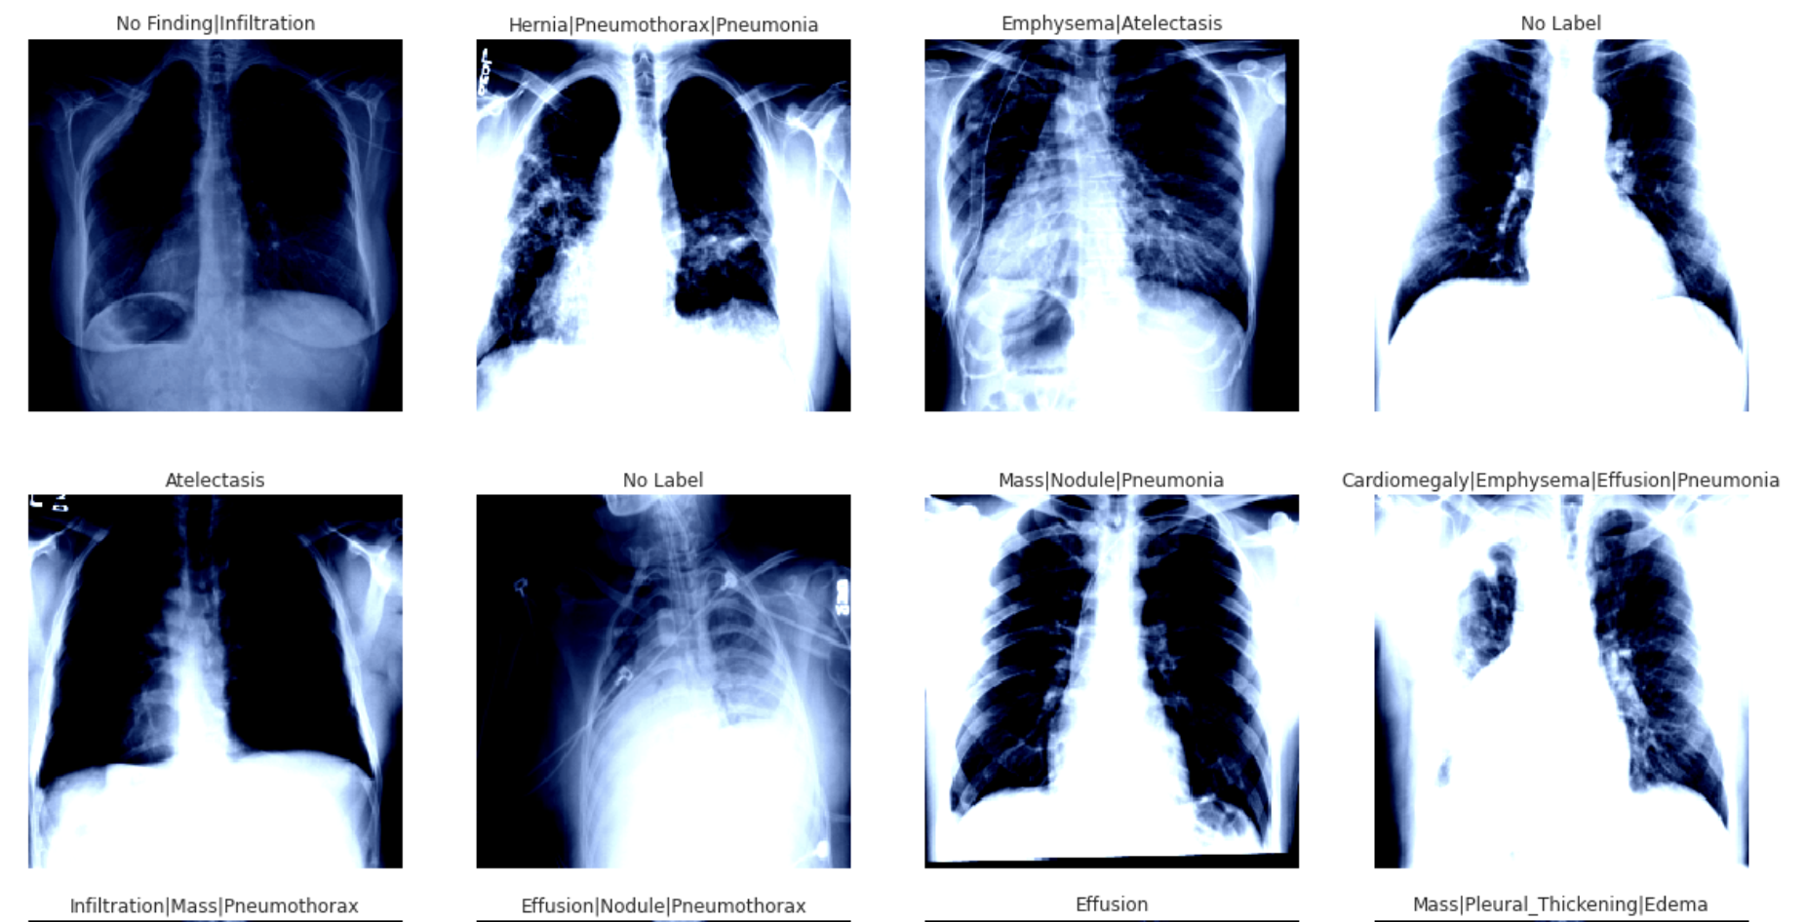
Visualizing images with labels from dataset

Slide 11
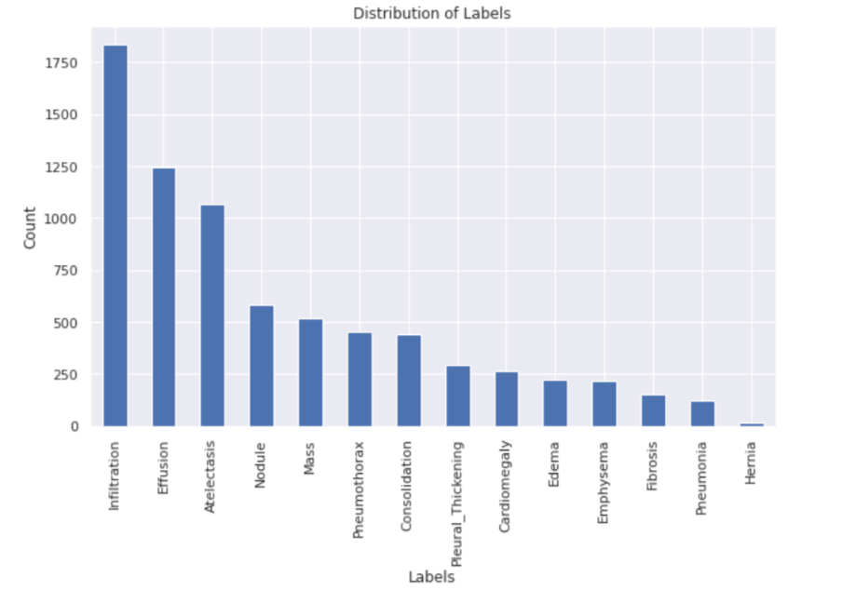
Class Distribution
Class Imbalance visible
Drastic difference between minority and majority class even after dropping No Findings

Slide 12
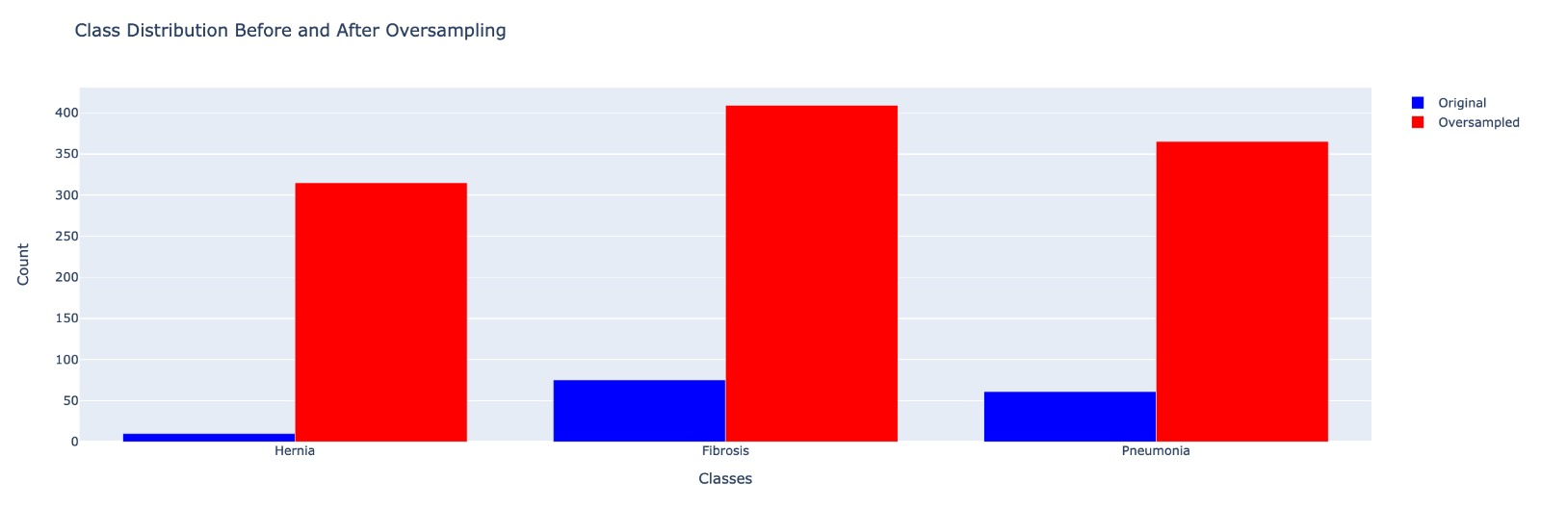
Visualization after Oversampling on Minority classes

Slide 13
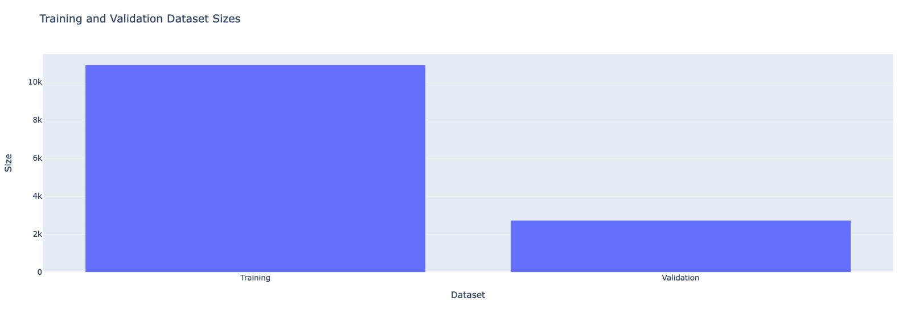
Data Split after Oversampling

Slide 14
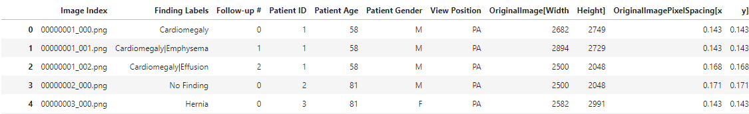
Raw Dataset
Age, Gender, View Position, Follow up visits are irrelevant to image classification

Slide 15
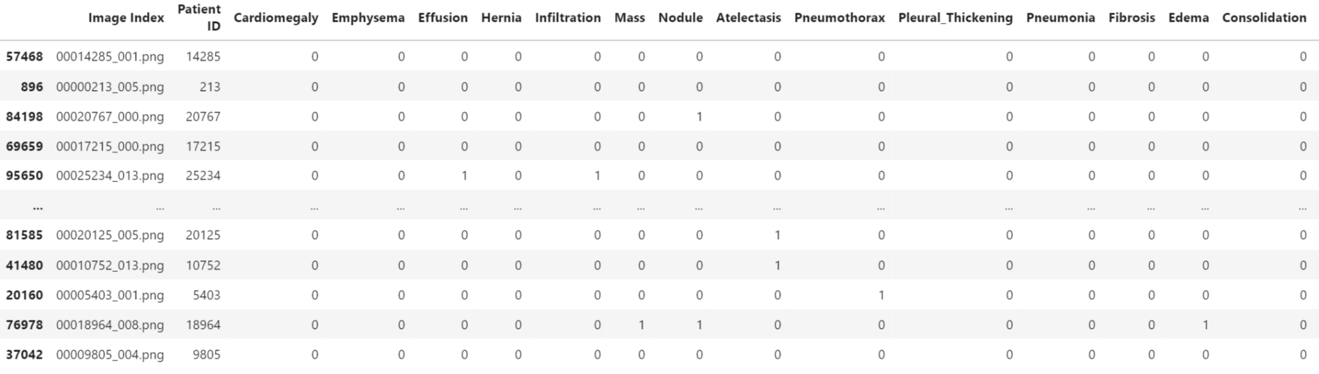
Processed Dataframe for Training

Slide 16
Data Preprocessing - I
Utilizing only images and labels for Multi-label classification of diseases
Age, Gender, View Position do not factor into disease prediction in the images
Removed bad labels in correlation with another dataset that directly maps to the NIH dataset.
Removed ‘No Findings’ due to heavy skew in data as observed earlier

Slide 17
Data Preprocessing - II
Avoided Explicit Encoding in ‘Disease Label’ by splitting into multiple features dedicated to each disease
Conditional Oversampling on minority classes:
Computing the count of minority classes
Calculate deficit
Append resampled instances
Randomly Shuffle
Why not SMOTE?
Effective only for Numerical and categorical data, not image data

Slide 18
Data Preprocessing - III
Image Transformations
Resize inputs to 256 x 256
RandomCrop 224
RandomHorizontalFlip
transforms.ToTensor
transforms.Normalize

Slide 19
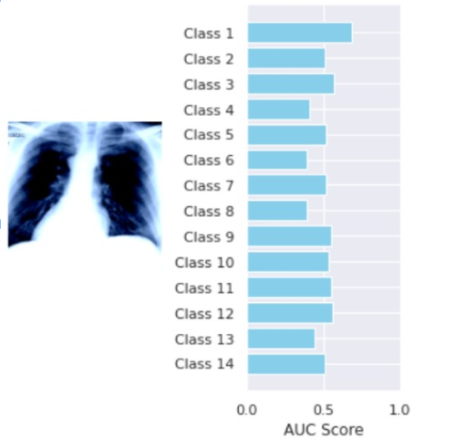
Getting Model Inference on a few Images
Can gain inference on images for evaluation metrics from each model to determine disease
Can implement a threshold depending on distribution or performance to classify with confidence

Slide 20
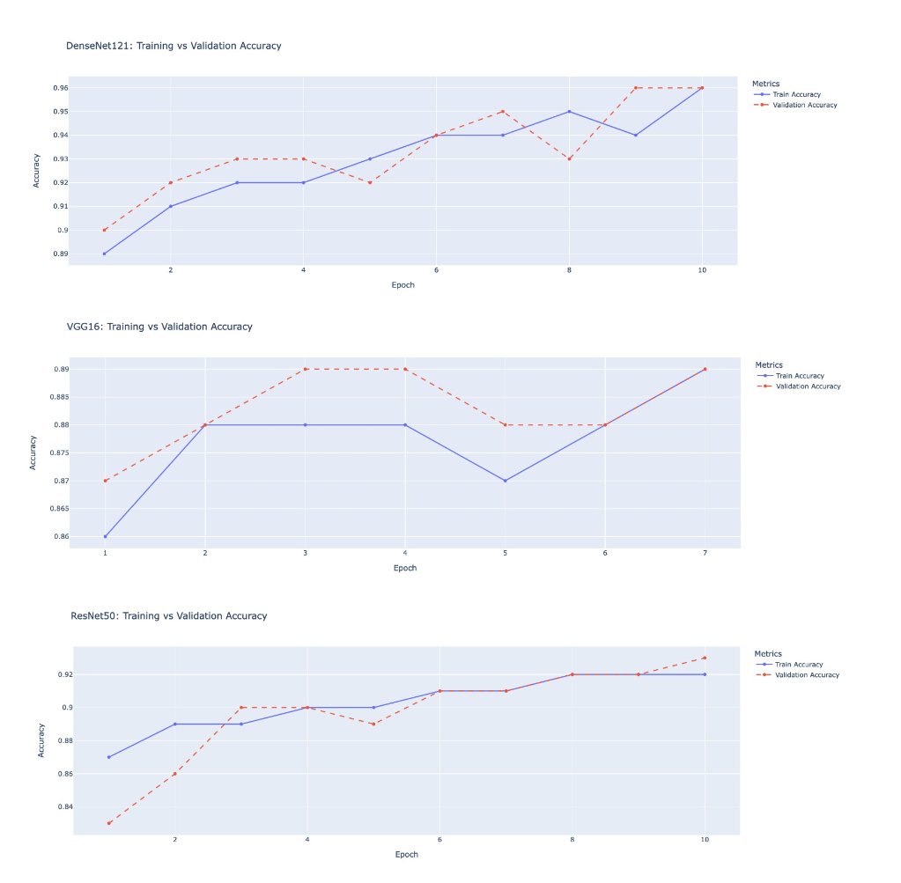
Training vs Validation Accuracy
Final Validation Accuracy for densenet121: 0.956901526677509
Train Acc: 0.96
Final Validation Accuracy for vgg16: 0.8891453753737999
Train Acc: 0.89
Final Validation Accuracy for resnet50: 0.926708986936677
Train Acc: 0.92

Slide 21
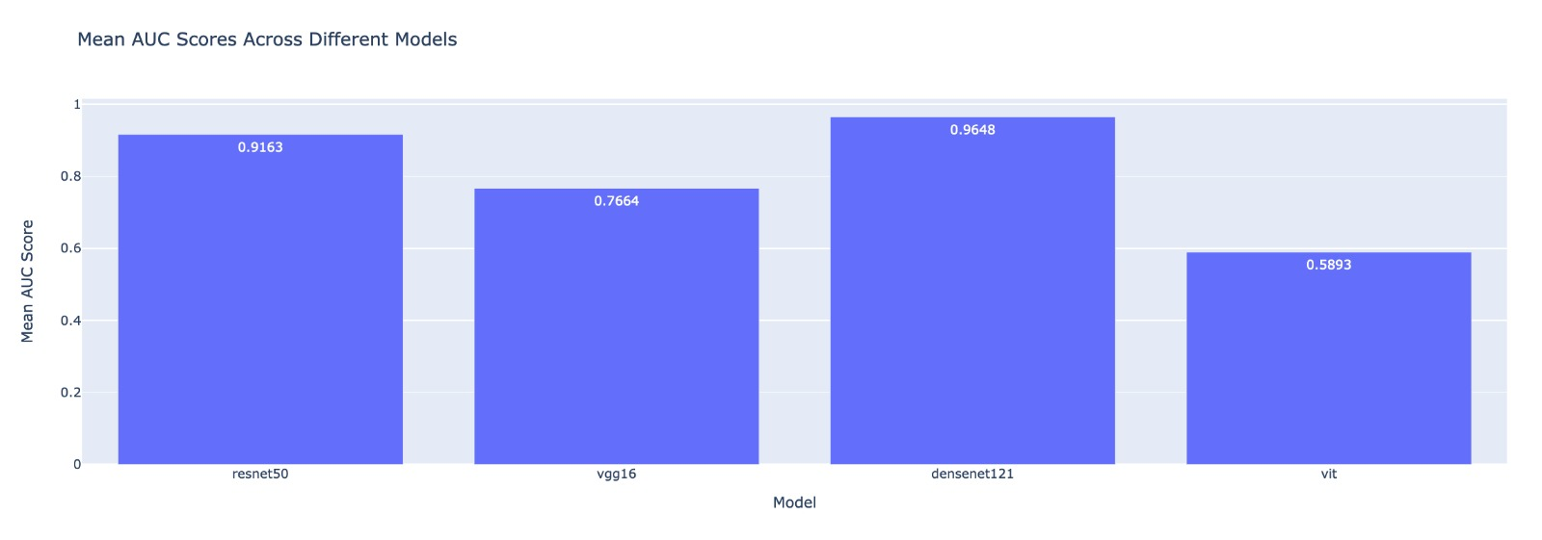
Mean AUC Scores

Slide 22
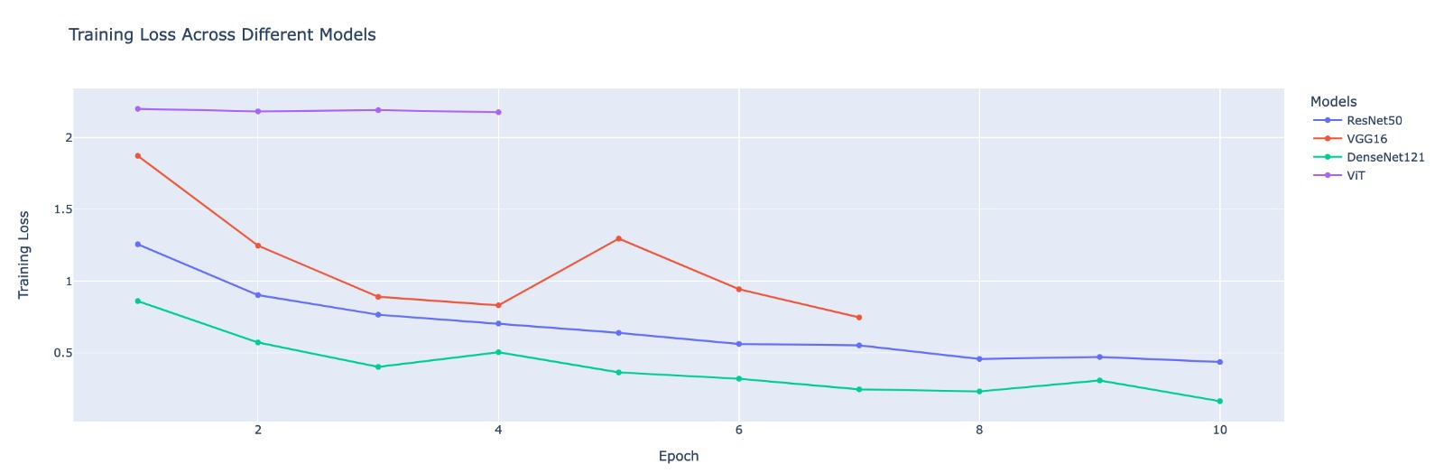
Training Loss across all the Models

Slide 23
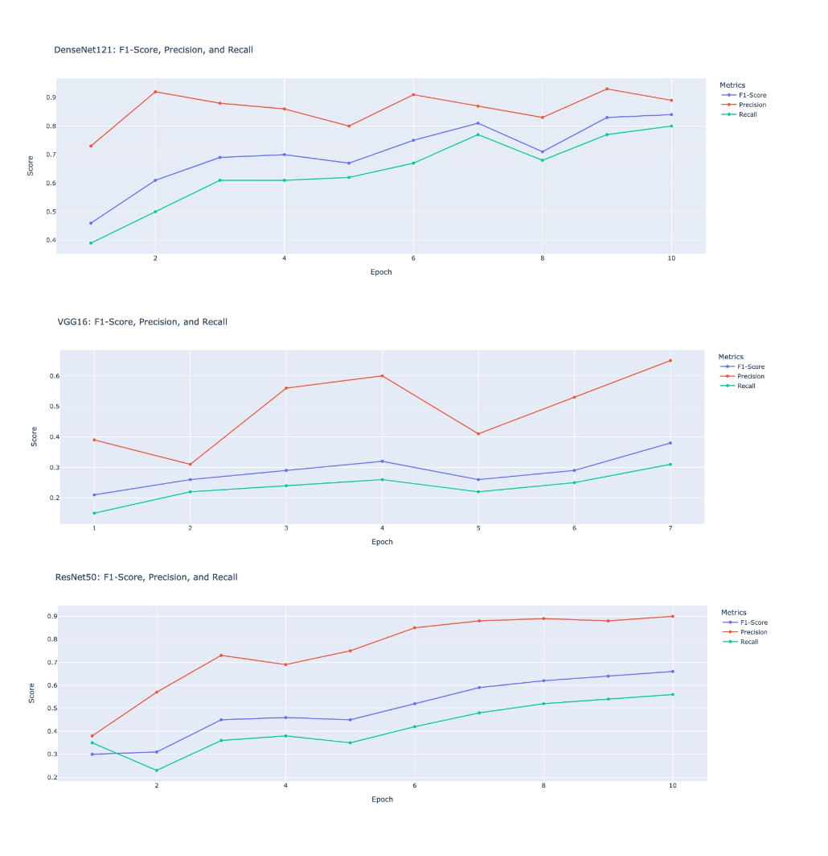
F1-Score, Precision and Recall across all Models

Slide 24
Conclusion and areas to expand on
Could look into more complex neural network architectures to beat baseline DenseNet scores
Look into Hyper parameter tuning for VIT
Could look into Grad-CAM (Activation Mapping) per model, but need to identify key layers for each model

